Slide 1
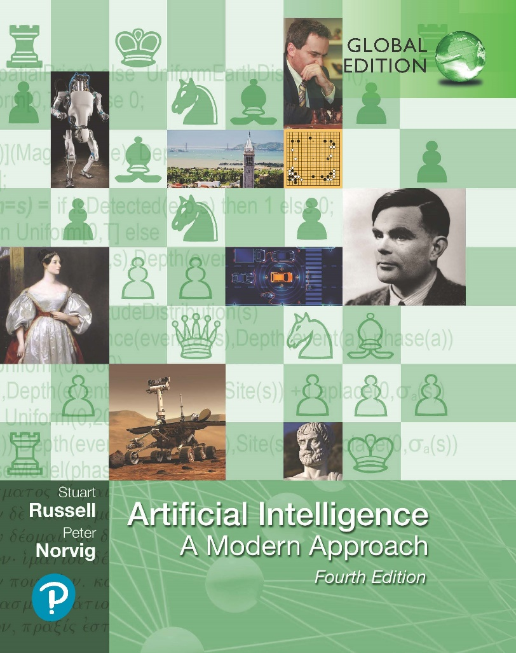
Artificial Intelligence: A Modern Approach
Fourth Edition, Global Edition
Chapter 23
Reinforcement Learning
© 2022 Pearson Education Ltd.

Slide 2
Outline
Learning from Rewards
Passive Reinforcement Learning
Active Reinforcement Learning
Generalization in Reinforcement Learning
Policy Search
Apprenticeship and Inverse Reinforcement Learning
Applications of Reinforcement Learning

Slide 3
Learning from Rewards
Agent interacts with the world and periodically receives rewards (reinforcements)
Varieties of approaches:
Model-based reinforcement learning: uses a transition model
Model may be initially unknown
Learns from observing effects of actions
Uselul for state estimation
Learn a utility function U (s),
Model-free reinforcement learning: neither knows nor learns transition model
Action-utility learning: most common form Q-learning, where the agent learns a Q-function, or quality-function, Q(s, a), denoting the sum of rewards from state s d if action a is taken.
Policy search: learns a policy π(s) that maps directly from states to actions.

Slide 4
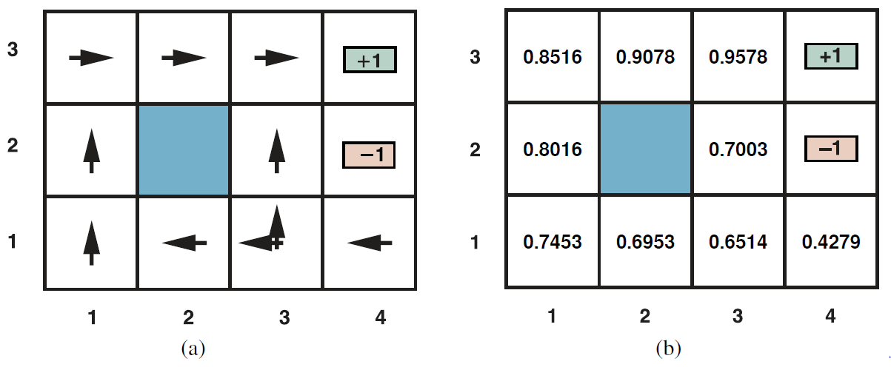
Learning from Rewards
Passive Reinforcement Learning
The optimal policies for the stochastic environment with R(s, a, s^{t}) = 0.04 for transitions between nonterminal states. There are two policies because in state (3,1) both Left and Up are optimal.
The utilities of the states in the 4 × 3 world, given policy

Slide 5
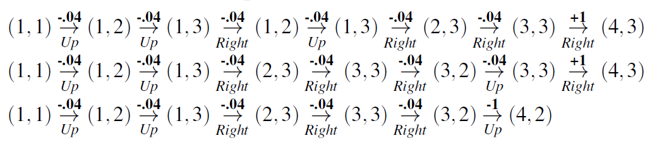
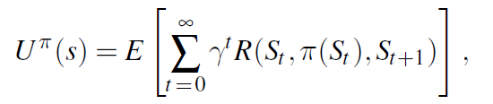
Learning from Rewards
Passive Reinforcement Learning
Passive learning agent: agent that learns the utility function U ^{π}(s)
Expected total discounted reward if policy π is executed beginning in state s
does not know the transition model P(s‘| s, a),
executes a set of trials in the environment using its policy π. starts in state (1,1) and experiences a sequence of state transitions until it reaches one of the terminal states, (4,2) or (4,3).
Expected utility

Slide 6

Learning from Rewards
Direct utility estimation
utility of a state is defined as the expected total reward from that state onward (reward-to-go)
at the end of each sequence, the algorithm calculates the observed reward-to-go for each state and updates the estimated utility
reduced reinforcement learning to a standard supervised learning problem in which each example is a (state, reward-to-go) pair.
The utility of a state is determined by the reward and the expected utility of the successor states

Slide 7
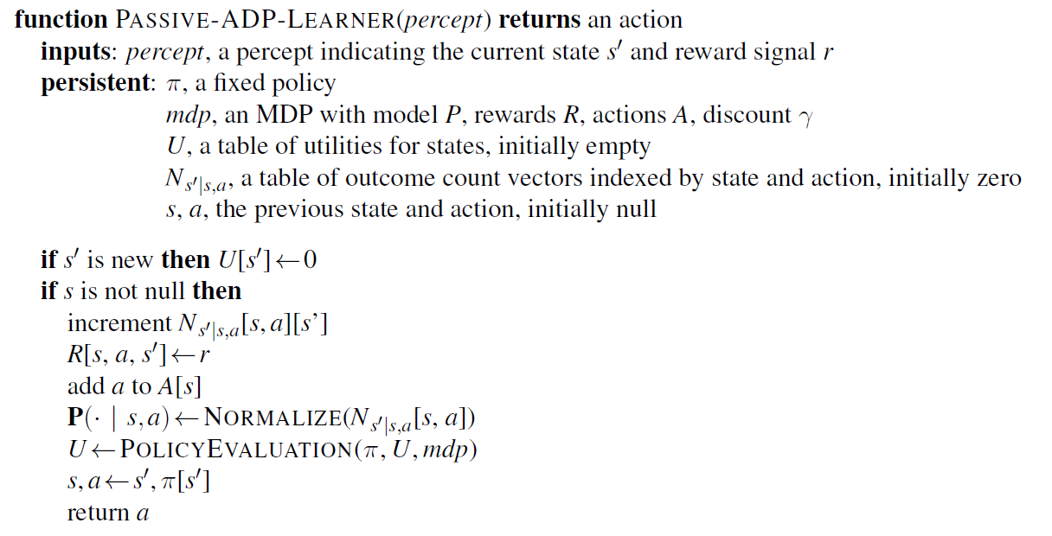
Learning from Rewards
Adaptive dynamic programming (ADP)
agent takes advantage of the constraints among the utilities of states by learning the transition model that connects them
Solving the corresponding Markov decision process using dynamic programming

Slide 8
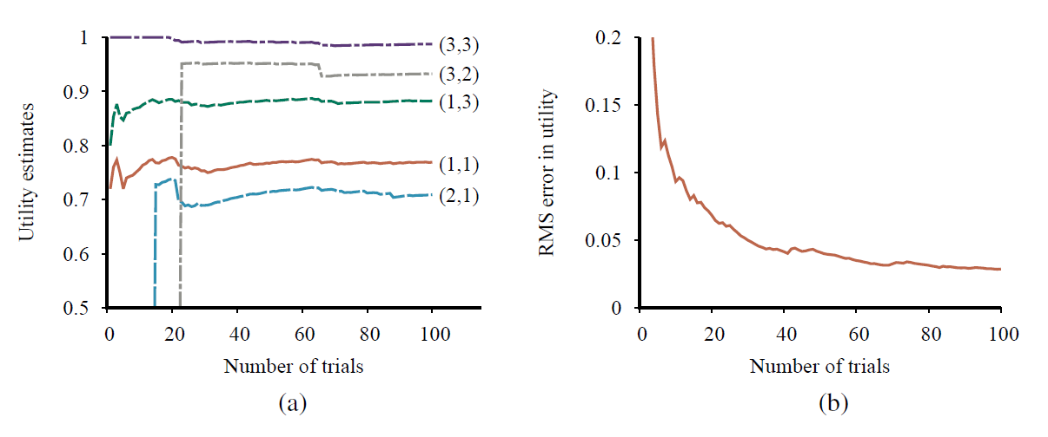
Learning from Rewards
The passive ADP learning curves for the 4 x 3 world.
The utility estimates for a selected subset of states, as a function of the number of trials. Notice that it takes 14 and 23 trials respectively before the rarely visited states (2,1) and (3,2) “discover” that they connect to the +1 exit state at (4,3).
The root-mean-square error in the estimate for U (1, 1), averaged over 50 runs of 100 trials each.

Slide 9
Learning from Rewards
Temporal-difference learning
use the observed transitions to adjust the utilities of the observed states so that they agree with the constraint equations.
Temporal-difference (TD) equation
α is the learning rate parameter.
uses the difference in utilities between successive states (and thus successive times)
adjusting the utility estimates toward the ideal equilibrium that holds locally when the utility estimates are correct
does not need a transition model to perform its updates.
TD adjusts a state to agree with its observed successor | ADP adjusts the state to agree with all of the successors that might occur, weighted by their probabilities
TD makes a single adjustment per observed transition

Slide 10
Learning from Rewards
TD adjusts a state to agree with its observed successor | ADP adjusts the state to agree with all of the successors that might occur, weighted by their probabilities
TD makes a single adjustment per observed transition | ADP makes as many as it needs to restore consistency between the utility estimates U and the transition model P.
For each observed transition, the TD agent can generate a large number of imaginary transitions | can generate more efficient versions of ADP by directly approximating the algorithms for value iteration or policy iteration.

Slide 11
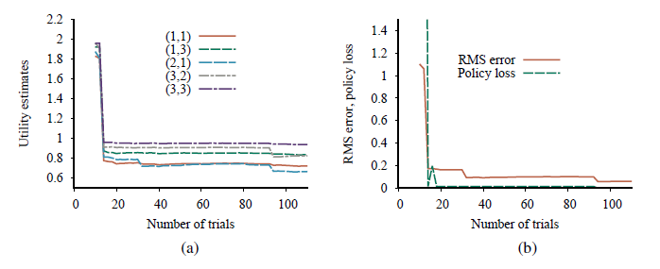
Learning from Rewards
Performance of the exploratory ADP agent using R⁺ = 2 and N_{e} = 5.
Utility estimates for selected states over time.
The RMS error in utility values and the associated policy loss.

Slide 12
Active Reinforcement Learning
Passive agent has a fixed policy that determines its behavior
Active learning agent gets to decide
Exploration
ADP sticks to policy, never learning the utilities of the other states and never finding the optimal route.
Also termed as a greedy agent: greedily takes the action that it believes
Sometimes this approach pays off and sometimes it does not
Overlook that actions do more than provide rewards
Actions provide information in the form of percepts in the resulting states
Not greedy in immediate next move but Greedy in Limit of infinite exploration (GLIE)
GLIE scheme must try each action in each state an unbounded number of times
to avoid having a finite probability that an optimal action is missed.

Slide 13
Active Reinforcement Learning
Safe Exploration
Many actions are irreversible
no subsequent sequence of actions can restore the state to what it was before the irreversible action was taken
Worst case: agent enters absorbing state (no actions have any effect/rewards)
choose a policy that works reasonably well for the whole range of models that have a reasonable chance of being the true model
even if the policy happens to be suboptimal for the maximum-likelihood model.
Three mathematical approaches:
Bayesian reinforcement learning
Exploration POMDP
Robust control theory

Slide 14
Active Reinforcement Learning
Temporal-difference Q-learning
Q-learning method avoids the need for a model by learning an action-utility function Q(s, a) instead of a utility function U (s).
derive a model-free TD update for the Q-values
No transition model
SARSA (for state, action, reward, state, action).
updates with the Q-value of the action a/ that is actually taken:

Slide 15
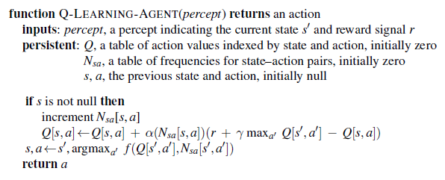
Active Reinforcement Learning
An exploratory Q-learning agent. It is an active learner that learns the value Q(s, a) of each action in each situation. It uses the same exploration function f as the ex- t, but avoids having to learn the transition model.

Slide 16


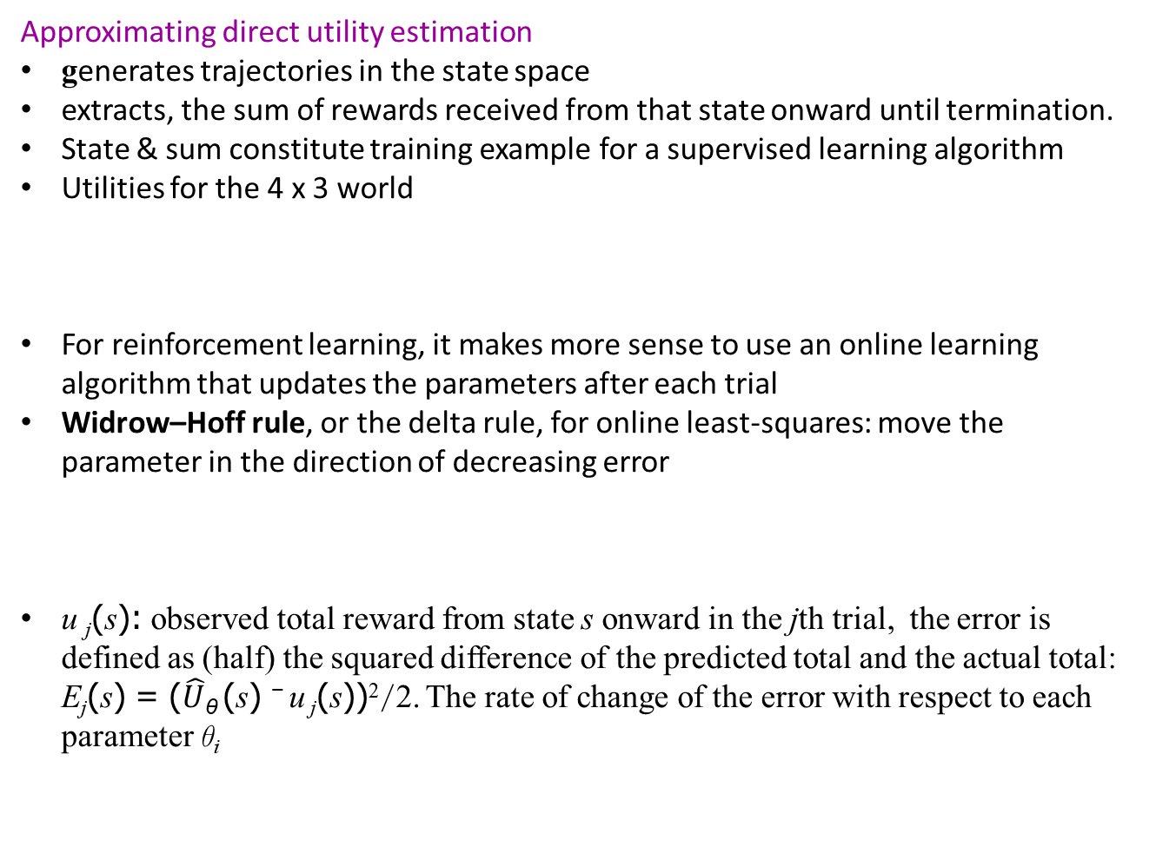
Generalization in Reinforcement Learning
Approximating direct utility estimation
generates trajectories in the state space
extracts, the sum of rewards received from that state onward until termination.
State & sum constitute training example for a supervised learning algorithm
Utilities for the 4 x 3 world
For reinforcement learning, it makes more sense to use an online learning algorithm that updates the parameters after each trial
Widrow–Hoff rule, or the delta rule, for online least-squares: move the parameter in the direction of decreasing error
u _{j}(s): observed total reward from state s onward in the jth trial, the error is defined as (half) the squared difference of the predicted total and the actual total: E_{j}(s) = ($\hat{U}$_{θ} (s) ⁻ u _{j}(s))²/2. The rate of change of the error with respect to each parameter θ_{i}

Slide 17
Generalization in Reinforcement Learning
Approximating direct utility estimation
catastrophic forgetting
learned too well: forgotten the earlier trainings
quadratic features get zero weight
experience replay
Retain trajectories from entire learning process and replay trajectories to ensure value function is accurate
Deep reinforcement learning (Deep RL)
beyond linear function approximators
No good linear function close to approximating utility function/Q-function
Not able invent necessary features (new domains)
Require more complex, nonlinear function approximators
However Deep RL is difficult to get good performance and the trained system may behave very unpredictably if the environment differs even a little from the training data

Slide 18

Generalization in Reinforcement Learning
Reward shaping
credit assignment problem: work out what agent did wrong
Reward shaping is supplying the agent with additional rewards, called pseudorewards
Hierarchical reinforcement learning
hierarchical reinforcement learning (HRL) much in common with the HTN planning
begins with a partial program that outlines a hierarchical structure for the agent’s behavior
extends any ordinary programming language by adding primitives for unspecified choices that must be filled in by learning
based on the concept of the joint state space, in which each state (s, m) is composed of a physical state s and a machine state m.
A choice state σ =(s, m) is one in which the program counter for m is at a choice point in the agent program.

Slide 19


Policy Search
idea is to keep twiddling the policy as long as its performance improves, then stop.
interested primarily in parameterized representations of π that have far fewer parameters than there are states in the state space
Problem: policy is a discontinuous function of the parameters when the actions are discrete
stochastic policy representation π (s, a), which specifies the probability of selecting action a in state s such as softmax:
policy gradient vector ∇_{θ}ρ(θ), provided ρ(θ) is differentiable.

Slide 20

Apprenticeship and Inverse Reinforcement Learning
The general field of apprenticeship learning studies the process of learning how to behave well given observations of expert behavior
Imitation learning: applying supervised learning to the observed state–action pairs to learn a policy π(s).
Inverse reinforcement learning (IRL): learning rewards by observing a policy
Understand why: observe the expert’s actions (and resulting states) and try to work out what reward function the expert is maximizing
derive an optimal policy with respect to that reward function
feature matching: assumes that the reward function can be written as a weighted linear combination of features

Slide 21
Applications of Reinforcement Learning
Applications in game playing
deep Q-network (DQN) system, the first modern deep RL system by DeepMind
DQN was trained separately on each of 49 different Atari video games
learned to drive simulated race cars, shoot alien spaceships, and bounce balls with paddles
DeepMind’s ALPHAGO beat the best human players
Application to robot control
cart–pole balancing problem, also known as the inverted pendulum
radio-controlled helicopter flight
used policy search over large MDPs
often combined with imitation learning and inverse RL given observations of a human expert pilot

Slide 22
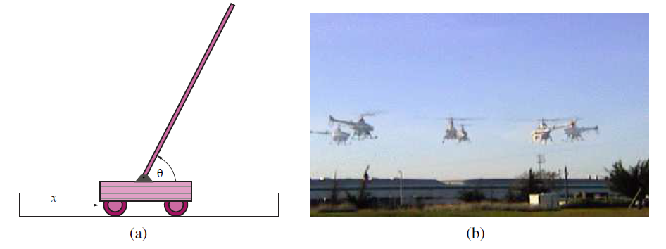
Applications of Reinforcement Learning
Setup for the problem of balancing a long pole on top of a moving cart. The cart can be jerked left or right by a controller that observes the cart’s position x and velocity x˙, as well as the pole’s angle θ and rate of change of angle θ˙.
Six superimposed time-lapse images of a single autonomous helicopter performing a very difficult “nose-in circle” maneuver. The helicopter is under the control of a policy developed by the PEGASUS policy-search algorithm (Ng et al., 2003). A simulator model was developed by observing the effects of various control manipulations on the real helicopter; then the algorithm was run on the simulator model overnight. A variety of controllers were developed for different maneuvers. In all cases, performance far exceeded that of an expert human pilot using remote control. (Image courtesy of Andrew Ng.)

Slide 23
Summary
A model-based reinforcement learning has a transition model P(s^{t} | s, a) for the environment and learns a utility function U (s).
A model-free reinforcement learning agent may learn an action-utility function Q(s, a) or a policy π(s).
Utility learning approach:
Direct utility estimation
Adaptive dynamic programming (ADP)
Temporal-difference (TD)
Reward shaping and hierarchical reinforcement learning are helpful for learning complex behaviors
Policy-search methods operate directly on a representation of the policy, attempting to improve it based on observed performance
Apprenticeship learning through observation of expert behavior can be an effective solution when a correct reward function is hard to specify.

